Slide 1
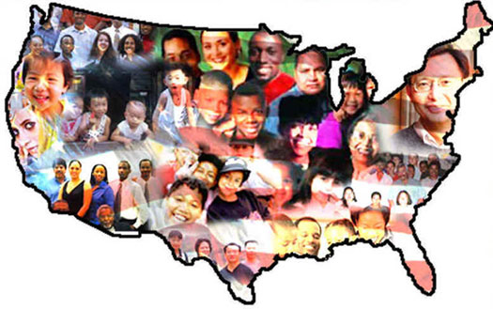
LIHEAP and Mixed-Status Households
This Training Tool has been prepared by the LIHEAP Clearinghouse under contract with the U.S. Department of Health and Human Services, Division of Energy Assistance. The content of this publication does not necessarily reflect the views or policies of the DHHS, nor does mention of trade names, commercial products, organizations or program activities imply endorsement by the U.S. Government or compliance with HHS regulations.

Slide 2
What is a mixed-status household?
Domestic units in which the immigration status of at least one member is different from the others. A common example is a family in which one or more parents is an unqualified alien and one or more children is a citizen or qualified alien.
A noncitizen or unqualified alien is a person who enters the U.S. illegally or legally entered the U.S. but their immigration status has expired or been revoked.
Notes:
For this presentation we will use the term noncitizen.

Slide 3



Are all noncitizens here illegally?
YES
NO

Slide 4
Not Correct
Go back
and choose another answer

Slide 5

The following noncitizens are here legally
  Immigrant
  Lawful Permanent Resident
  Qualified Alien

Slide 6
Mixed-status families are complex. They may be made up of any combination of:
Legal Immigrants
Citizens
Unqualified Aliens

Slide 7
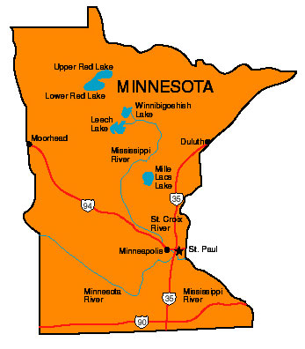
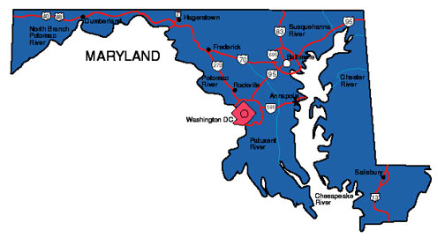
How do some grantees define mixed-status households?
Select a state to view an example

Slide 8
Maryland – Mixed-Status Household
“A mixed household is one in which one or more members are amnesty aliens and one or more members are not.“ (Maryland LIHEAP Manual)
I would like to see another state example.
Continue

Slide 9
Minnesota – Mixed-Status Family
“At least one adult is an eligible person in a household with other ineligibles or All adults are ineligible noncitizens that reside with one or more eligible children.” (Minnesota LIHEAP Manual)
I would like to see another state example.
Continue

Slide 10

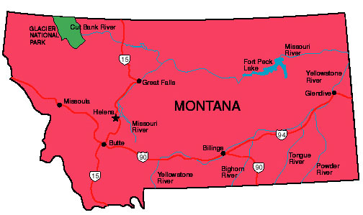
What type of individuals are considered ineligible household members?
Select a state

Slide 11
Montana
“Individuals of households who refuse to submit social security numbers, proof of citizenship or lawful entry into the U.S. with the intent of establishing permanent residency or qualified alien status will be deemed ineligible members of the household.” (Montana LIHEAP Manual)
I would like to see another state example.
Continue

Slide 12
Nevada
“The following individuals in Nevada are not considered to be eligible for LIHEAP: Ineligible Noncitizens; Persons noncompliant in providing Social Security Number (SSN); Persons/household disqualified due to an Intentional Program Violation (IPV)” (Nevada LIHEAP Manual)
I would like to see another state example.
Continue
Notes:
Might want to replace Nevada with another example

Slide 13
Are there many mixed-status households in the U.S.?
Center for American Progress, 2012 report
16.6 million people live in mixed-status families with at least one unauthorized immigrant
One third of U.S. citizen children of immigrants live in mixed-status families.
More than 7 million children in the U.S. live with parents from Mexico
  Half of these children were estimated to be U.S. citizens living with noncitizen parents

Slide 14
Are mixed-status households eligible for LIHEAP?
“Grantees are encouraged to provide LIHEAP assistance to eligible household members, and not to deny benefits solely due to the presence of one or more ineligible household members.”
(LIHEAP IM, December 2014)

Slide 15
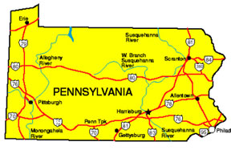
Welcoming Center for New Pennsylvanians
“It is important to know that U.S. citizen children of immigrant parents have the same rights to public benefits as all other citizens - regardless of the immigration status of their parents. For example, undocumented parents may apply for public benefits for their U.S. citizen children.”

Slide 16
If mixed-status households can receive LIHEAP, what is the issue?
Mixed-status households may be reluctant to apply for public benefits or LIHEAP.
Unqualified aliens are likely to fear detection and deportation.
Some don’t realize that a household with citizen children may be eligible.
Perception that participating in federal programs could affect immigration status or hurt a noncitizen's chances of becoming an American citizen.
Concern that receiving LIHEAP may affect an applicant’s financial sponsor.

Slide 17
What is the issue (continued)
Difficult to set policy for noncitizens without having unintended effects on citizens, particularly citizen children.
Confusing when members of the same family are treated differently. For example: if a child entered the U.S. 2 years ago, they may be ineligible for public services, but its sibling who was born in the U.S. would be eligible.
Bottom line - citizen children or qualified alien children in mixed-status households may be losing benefits.

Slide 18
What are the grantees responsibilities?
Grantees have flexibility under the block grant structure of LIHEAP to establish procedures for verifying an applicant’s U.S. citizenship and immigration status when determining eligibility for LIHEAP services
Refer to the U.S. Department of Justice interim guidance on verification of citizenship (62 FR 61344-61416).

Slide 19
Does HHS have guidance for grantees?
LIHEAP IM - HHS Guidance on the Use of Social Security Numbers (SSNs) and Citizenship Status Verification, December 2014
  Ensure that grantee policies and procedures do not discourage, delay or deny enrollment of eligible persons, including eligible children residing with ineligible noncitizens; and
  Remove access barriers by structuring enrollment procedures to allow non-applicants to declare early in the process whether they are seeking benefits only on behalf of eligible household members.

Slide 20
Do household members need a Social Security Number to apply for LIHEAP?
HHS is bound by the Privacy Act provisions and cannot compel Grantees to require Social Security Numbers (SSNs) as a condition of eligibility for LIHEAP, but advise that Grantees have discretionary authority to require SSNs in the administration of their LIHEAP programs.
If the grantee’s law or policies require SSNs, then individuals that do not have SSNs may be considered ineligible by the grantee. HHS strongly encourages, however, that grantees (a) assist such individuals with obtaining SSNs and the necessary documentation; and (b) avoid delaying or denying LIHEAP assistance to those household members pending such information if the individuals are otherwise eligible to receive LIHEAP benefits.

Slide 21
Are local agencies required to verify SSNs?
“a nonprofit charitable organization, in providing any Federal public benefit…or any State or local public benefit…is not required under this chapter to determine, verify, or otherwise require proof of eligibility of any applicant for such benefits.” (Section 432(d) of PRWORA (Personal Responsibility and Work Opportunity Reconciliation Act of 1996))
However, grantees are still responsible for determining and verifying program eligibility, including obtaining proof of “qualified alien” status while ensuring that eligible persons including those living with ineligible non-citizens are not denied assistance. (LIHEAP IM HHS Guidance on the Use of Social Security Numbers (SSNs) and Citizenship Status Verification)

Slide 22
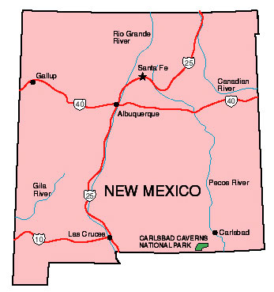
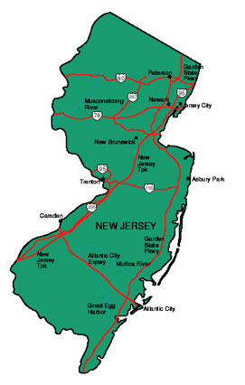
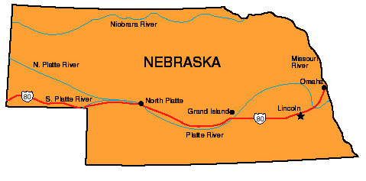
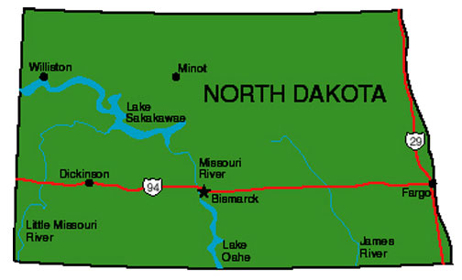
Noncitizens and Applications
Some grantees include questions about citizenship on applications.
Click on a state to see an example.

Slide 23
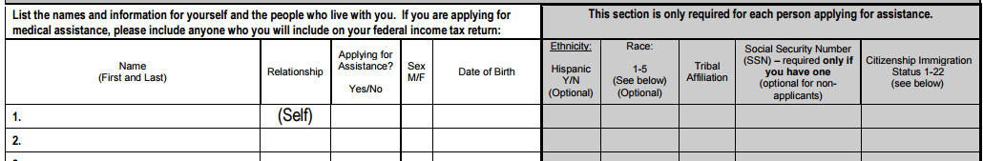
New Mexico Application
Tell us About the People who live with You:
  Please list everyone that lives in your household even if you do not want to apply for them. You only have to give U.S. Citizenship and Social Security Numbers for those household members that you are applying for assistance. Noncitizen immigrants not requesting assistance for themselves do not need to give immigration status information, Social Security Numbers, or other similar proofs; however, they must give information about their income because part of their income and things they own may count towards the household’s eligibility for assistance.
View another example
Continue

Slide 24
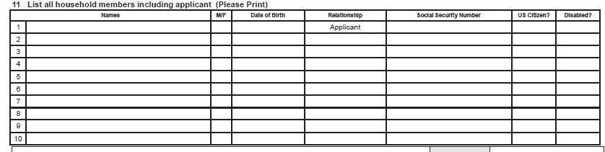
How are noncitizens addressed in applications?
New Jersey’s application asks if household members are U.S. citizens.
View another example
Continue

Slide 25
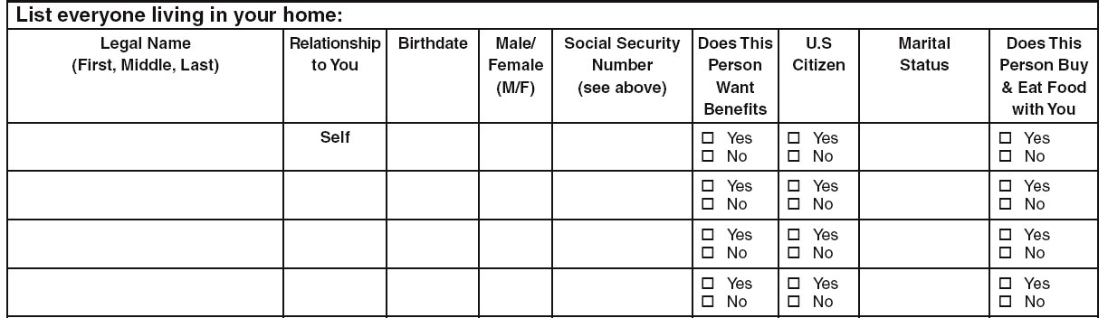
Nebraska Application
“Please list yourself and everyone living in your home, even if you are not applying for everyone. Social Security numbers and citizenship status are only required for those for whom you are applying.”
View another example
Continue

Slide 26
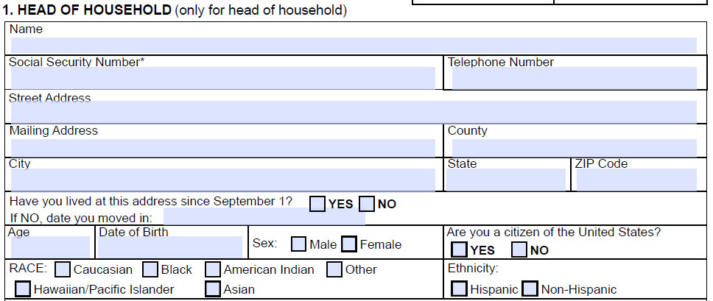
North Dakota’s application asks if the head of household is a U.S. citizen.
View another example
Continue

Slide 27
What is in the LIHEAP plan?
What are your procedures for ensuring that household members are U.S. citizens or aliens who are qualified to receive LIHEAP benefits?
Some states use SAVE - Systematic Alien Verification Entitlement
This system is a federally mandated repository used to verify immigration status.
North Carolina - If applicant refuses or does not provide documentation, consider him an ineligible alien.
Wisconsin - If the applicant states a household member does not have a Social Security Number (SSN) or valid immigration records, the individual shall be marked an ineligible noncitizen.

Slide 28
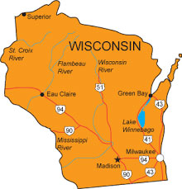

In mixed-status households, who can apply for LIHEAP?
In many states an ineligible household member may apply for benefits on behalf of eligible household members. Note also that states have different definitions for head of household, some may include minors.
See these state examples.

Slide 29
Wisconsin
A case head must be 18 years or older, or be a minor head-of-household, or be a child who meets one of the following exceptions:
1) All adults in the household are ineligible noncitizens; and
  o The dependent child is either a citizen or an eligible noncitizen; and
  o The child has an SSN.
  If there is an eligible noncitizen or U.S. citizen of any age in the household, the worker must encourage her/him to apply (become the case head)
  (Wisconsin LIHEAP Manual)
View another example
Continue

Slide 30
Utah
“The application should be in the name of one of the eligible adult household members, unless all the adults in the household are undocumented. The primary applicant must be over 18 or emancipated.” (Utah LIHEAP Manual)
View another example
Continue

Slide 31
Pennsylvania
“A noncitizen household member who does not qualify for benefits can be the payment name for the household.” (Pennsylvania LIHEAP Manual)
View another example
Continue

Slide 32
More examples from state LIHEAP manuals
Arizona – “A minor can be the head of household with supporting documentation such as rental agreement, and/or other appropriate documentation. “
New York – “Benefits may be issued in the name of a non-qualified alien only when eligible household members are minor children or when the non-qualified alien is the customer of record for the energy bill. “

Slide 33
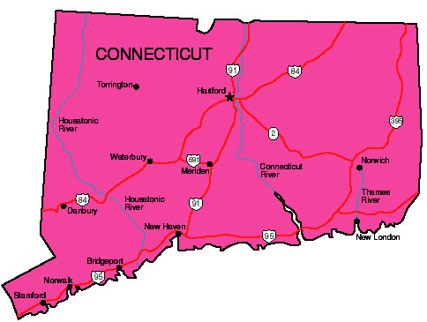
How do grantees determine benefits for mixed-status households?
The following practice is followed by many states and ensures that eligible household members are receiving a benefit but the benefit is reduced.
Income is counted for all household members regardless of citizen status.
Noncitizens are not included in the household size.

Slide 34
North Dakota
“When a non-qualified alien is a member of a LIHEAP household, their income and assets WILL be counted when determining LIHEAP eligibility. However, the non-qualified alien will NOT be counted as a member of the household.” (North Dakota LIHEAP Manual)
View another example
Continue

Slide 35
Connecticut
“Non-Qualified aliens shall not be included as part of the household when determining eligibility for energy assistance benefits. Income/liquid assets from non-qualified aliens shall be included when determining eligibility for energy assistance benefits.” (Connecticut LIHEAP Manual)
View another example
Continue

Slide 36
Summary – Best Practices
Eligible persons have the right to receive energy assistance. Some applicants (typically eligible children in families where other adults are not eligible) cannot apply on their own. They depend on adult household members to secure assistance.
Best Practice - States must be able to structure an application process that enables these members to apply for children without divulging information about their own immigration status.

Slide 37
Summary – Best Practices
The application process needs to inform potential applicants that they may apply for certain household members, and that persons who do not meet the immigration and SSN requirements will not receive benefits, but must provide other information to complete the application.
HHS recommends that the application have a section that distinguishes between eligible household members who are seeking assistance and ineligible members who are included strictly for purposes of determining income eligibility only.
The “applicant” does not need to be an eligible member of the household, but should be of legal age to apply on behalf of those members of the household who are eligible.

Slide 38
Summary – Best Practices
Determining Benefits
Count the income of ineligible members of the household when determining the total household’s income eligibility. (Income must be documented, verified, and included in the calculation of the LIHEAP benefit amount.)
Do not include ineligible members in the household size when determining a benefit.

Slide 39
Resources
This completes this training tool about mixed-status households and LIHEAP. Please see the following resources for more information:
LIHEAP IM - HHS Guidance on the Use of Social Security Numbers (SSNs) and Citizenship Status Verification, December 2014.
U.S. Department of Justice interim guidance on verification of citizenship (62 FR 61344-61416).
All under One Roof: Mixed-Status Families in an Era of Reform
by Michael Fix Wendy Zimmermann
State LIHEAP Manuals
State LIHEAP Applications

